Slide 1
Sensor and sensing tehcnologies
Software development engineering
Masters student batzorig shinebayar
Project movement detector

Slide 2
Movement detector with PIR sensor
Abstract:
This project uses PIR sensor, passive buzzer and RGB KS LED. If PIR sensor detect movement passive buzzer make sound in same time RGB KS LED will light it up red color. When movement ends passive buzzer stop making sound and RGB KS LED light it up green color.
Introduction to Sensor:
PIR Sensor:
PIR sensors allow you to sense motion, almost always used to detect whether a human has moved in or out of the sensors range. They are small, inexpensive, low-power, easy to use and don't wear out. For that reason they are commonly found in appliances and gadgets used in homes or businesses. They are often referred to as PIR, "Passive Infrared", "Pyroelectric", or "IR motion" sensors. PIRs are basically made of a pyroelectric sensor (which you can see above as the round metal can with a rectangular crystal in the center), which can detect levels of infrared radiation. Everything emits some low level radiation, and the hotter something is, the more radiation is emitted. The sensor in a motion detector is actually split in two halves. The reason for that is that we are looking to detect motion (change) not average IR levels. The two halves are wired up so that they cancel each other out. If one half sees more or less IR radiation than the other, the output will swing high or low.

Slide 3
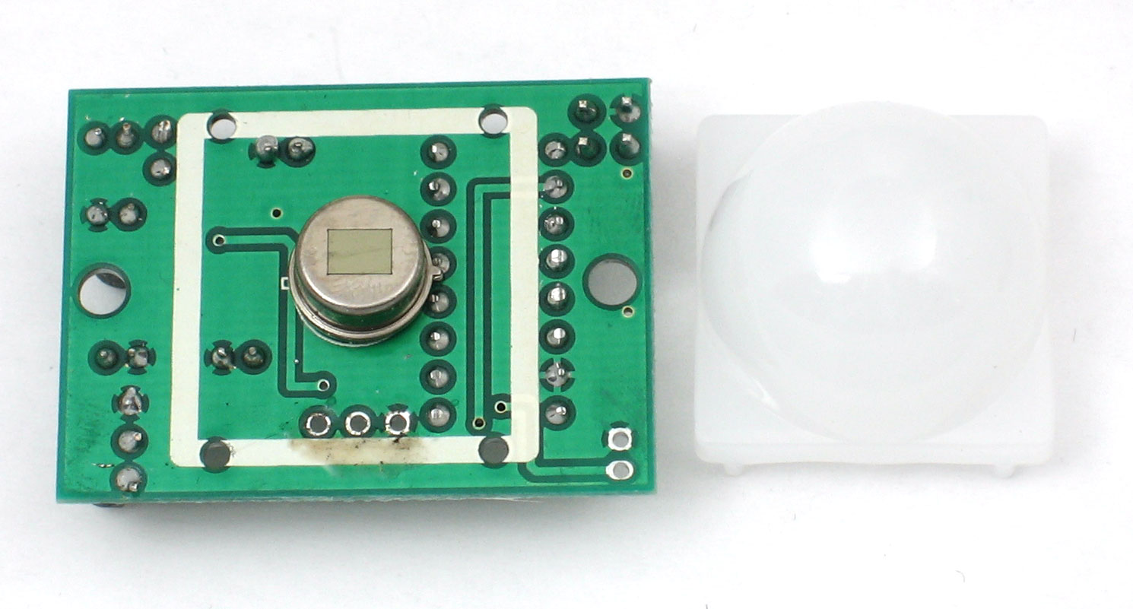
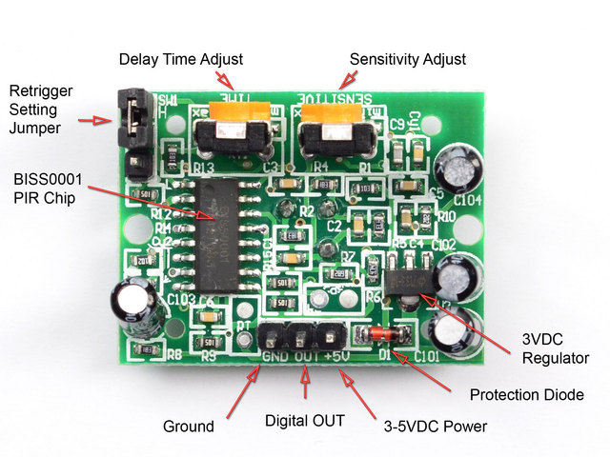
Movement detector with PIR sensor
Introduction to Sensor:
PIR Sensor:

Slide 4
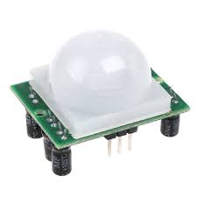
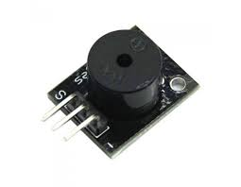
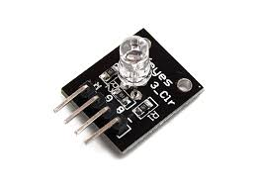
Movement detector with PIR sensor
Project Scope: This device will enable you to detect movement within certain area. This feature can be used in real time security application. This feature can help in security applications.
Components Required:
-RIP sensor
-Two resistors 220 ohms
-Jumper wires
-RGB KS LED
-Passive buzzer
-Breadboard

Slide 5
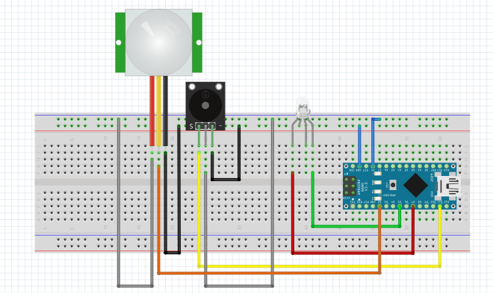
Movement detector with PIR sensor
5. Connection

